Slide 1

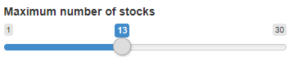
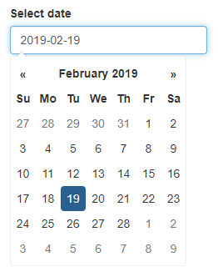
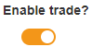
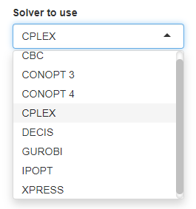
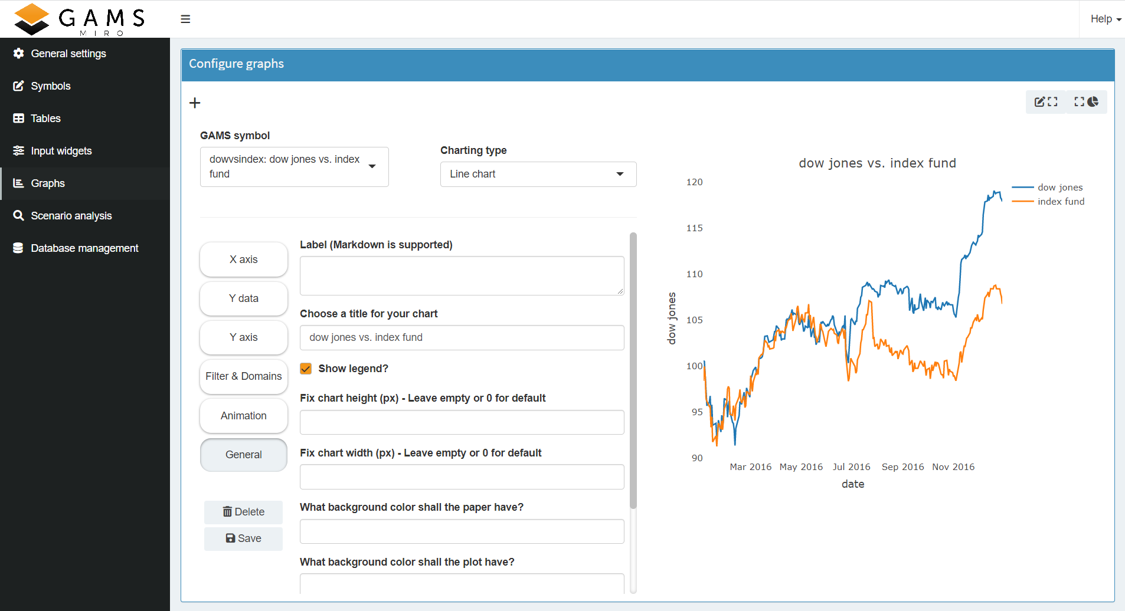
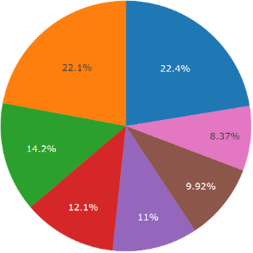
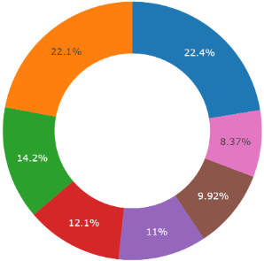
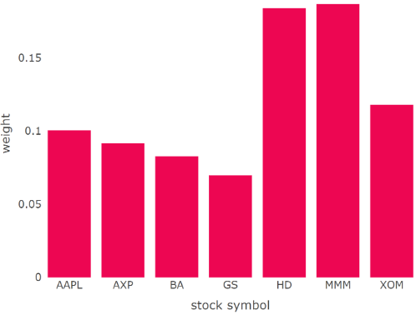
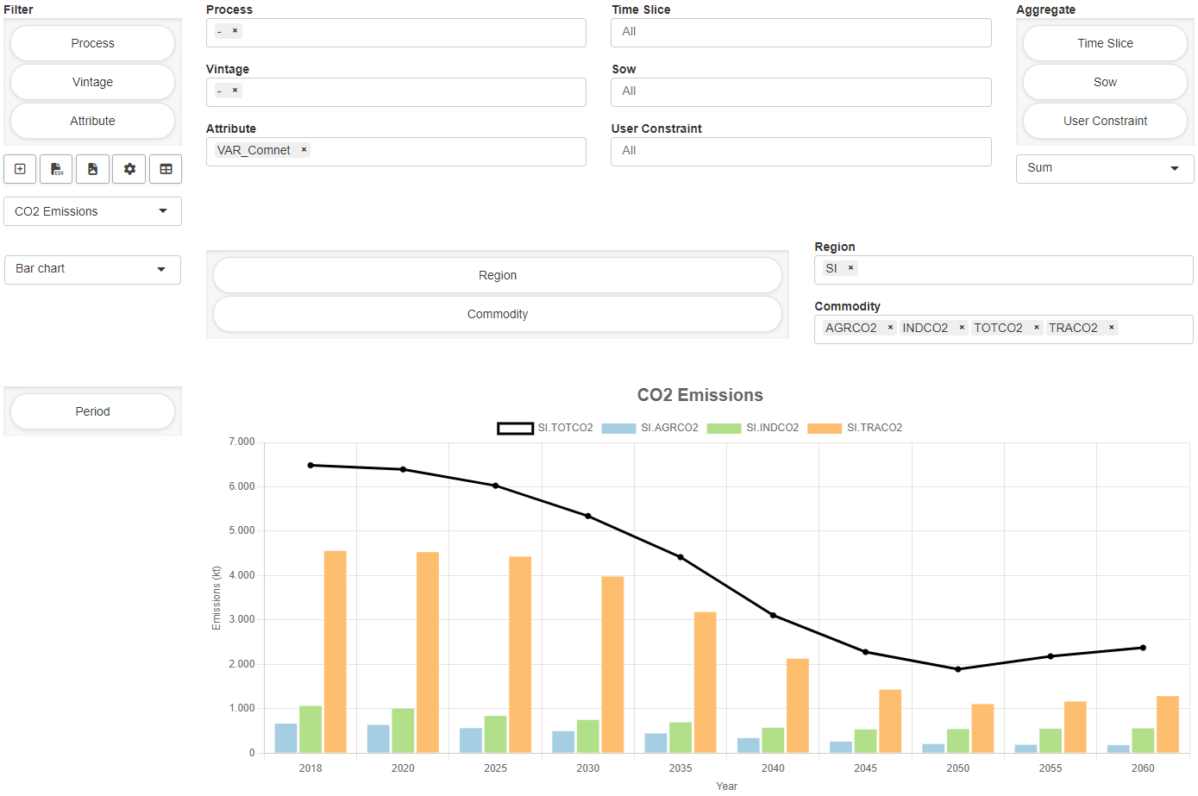
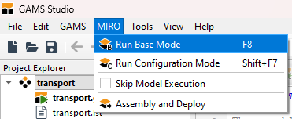
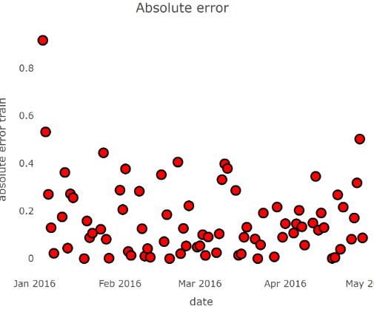
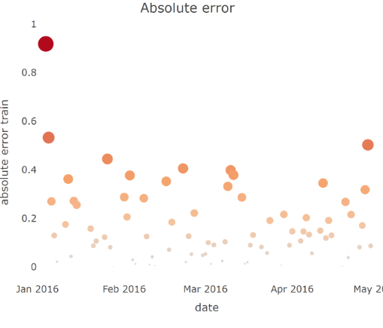
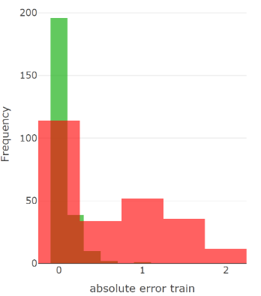
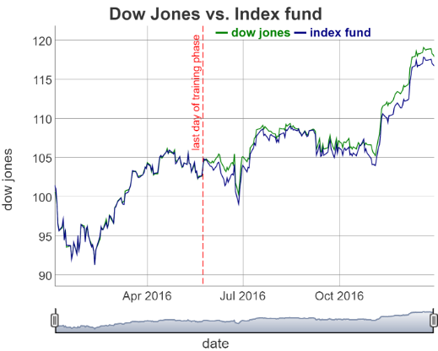
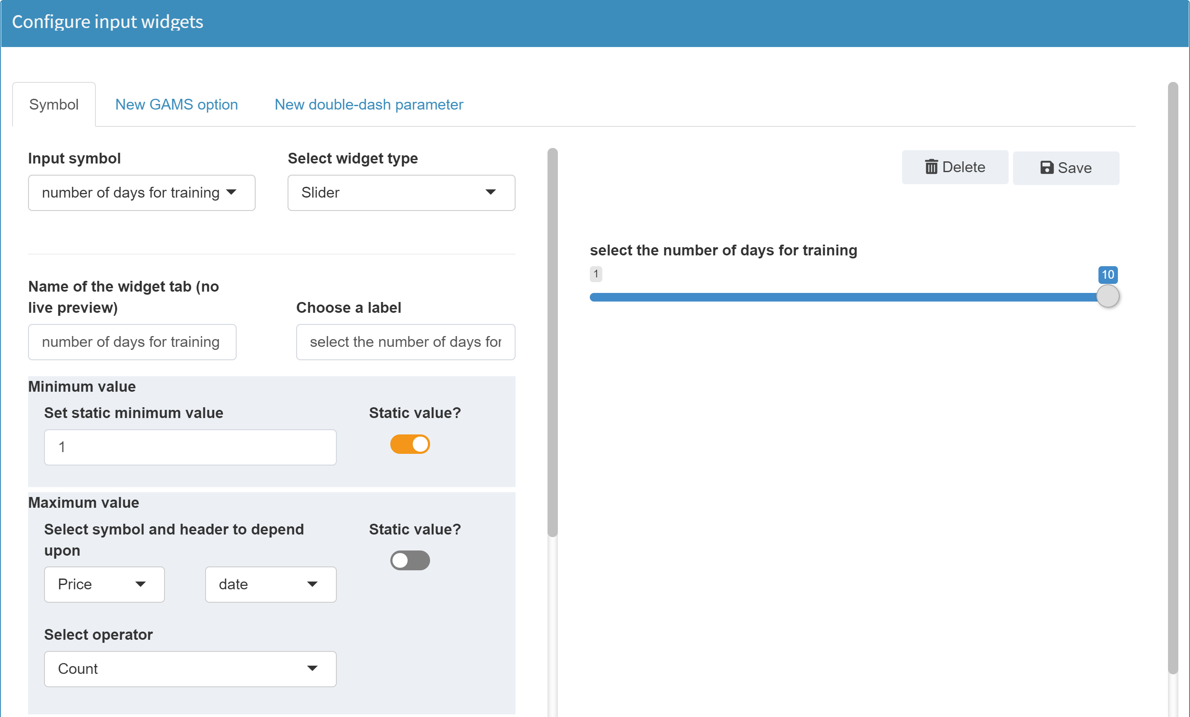
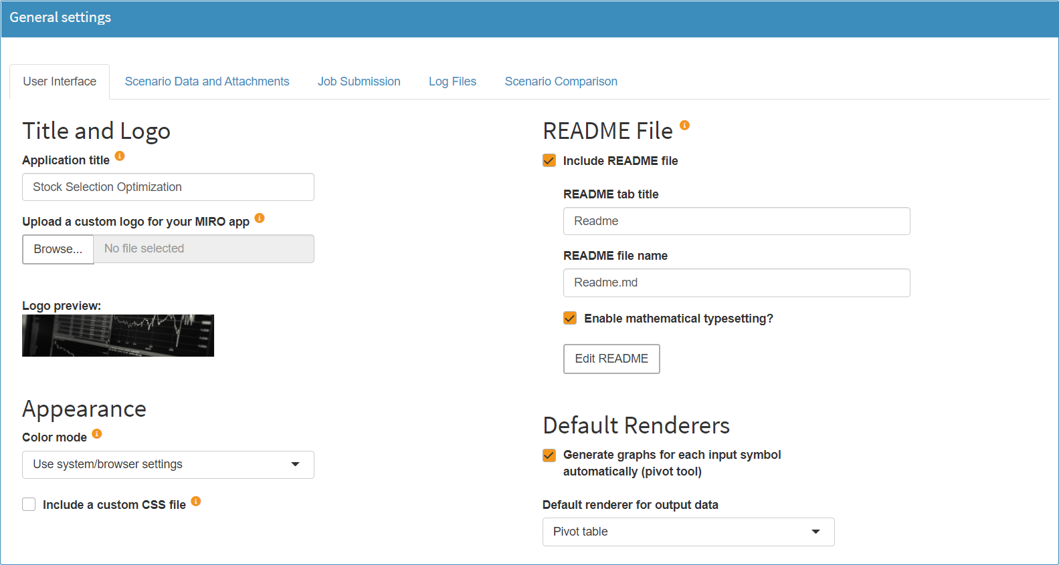
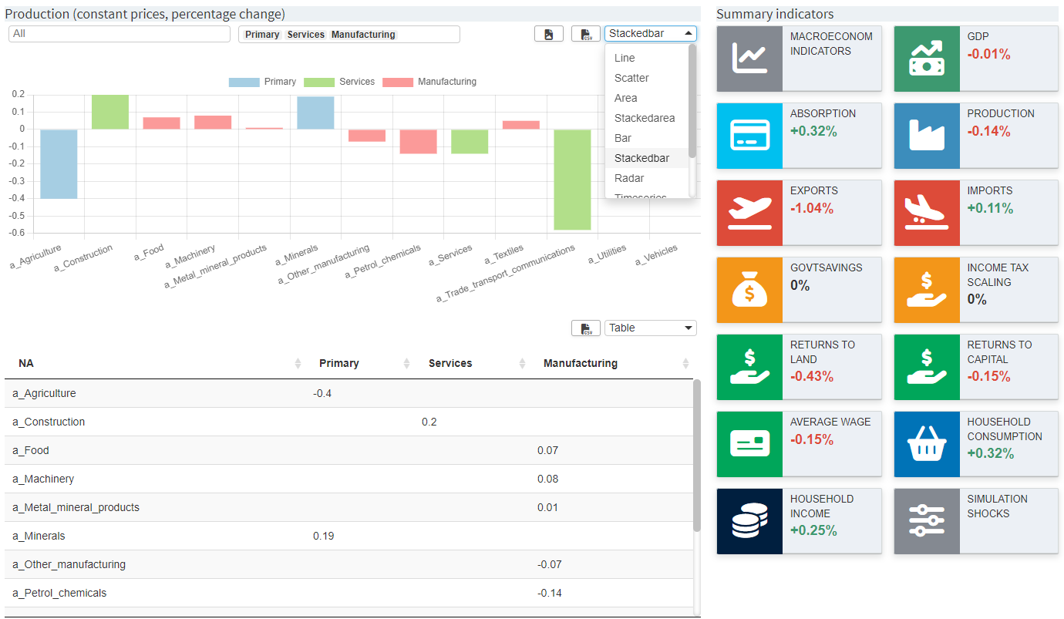
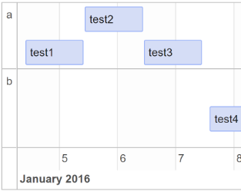
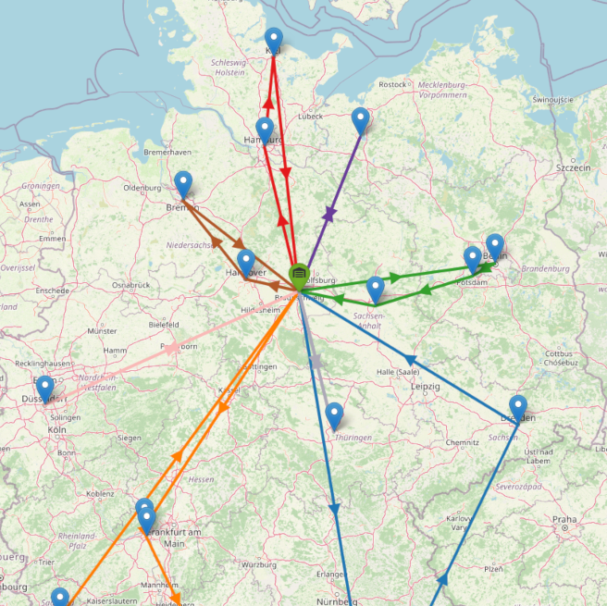
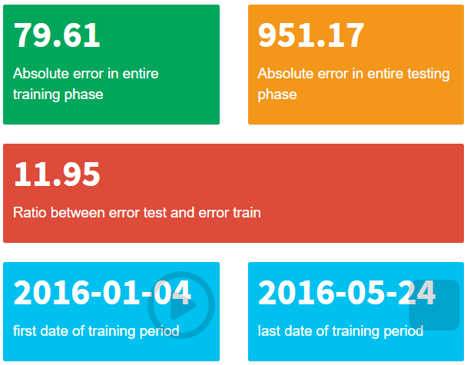
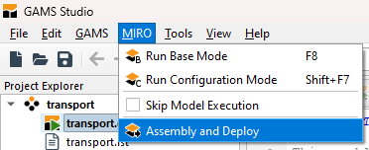
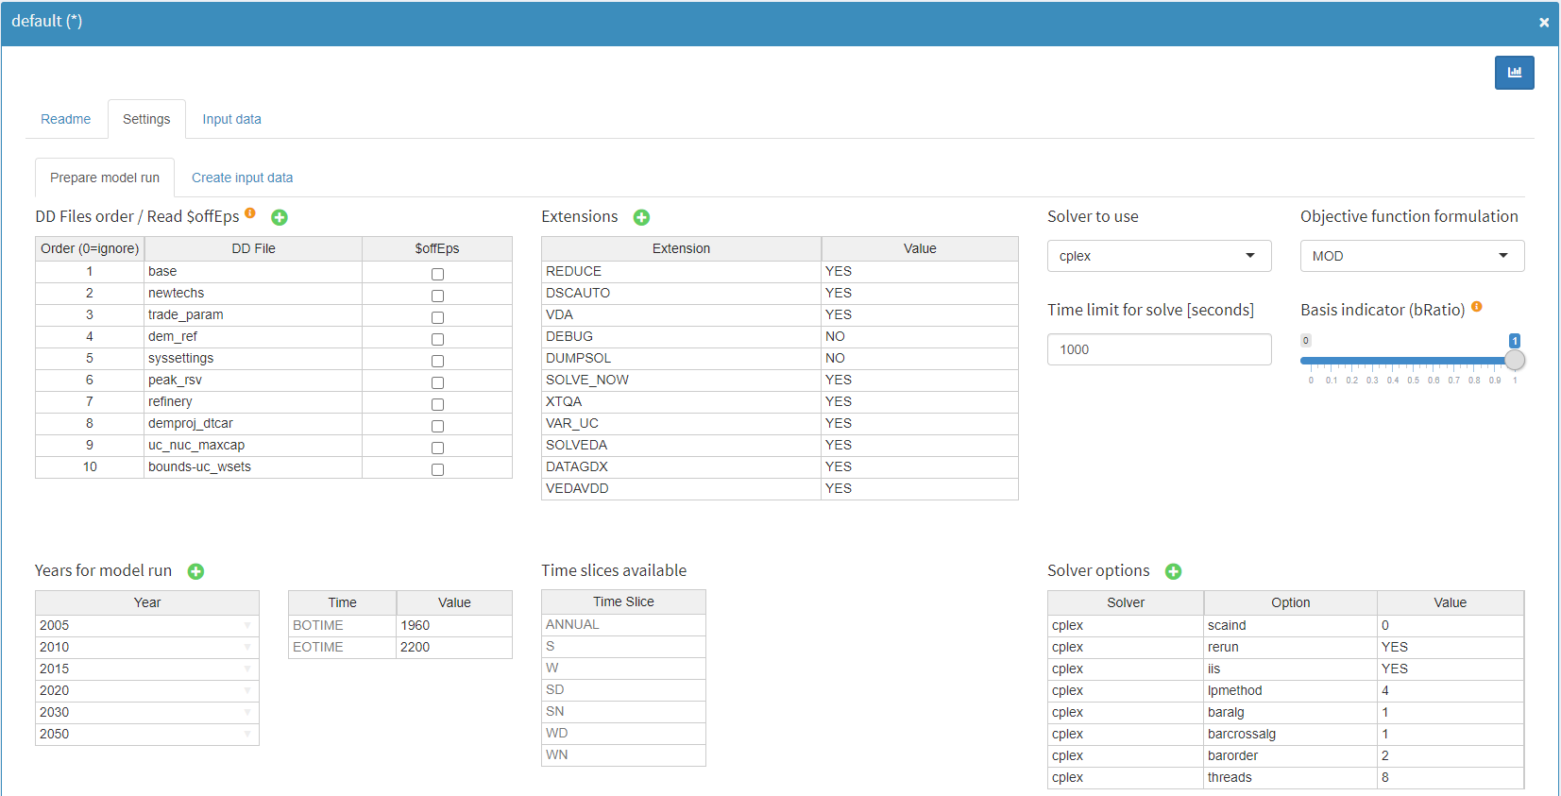
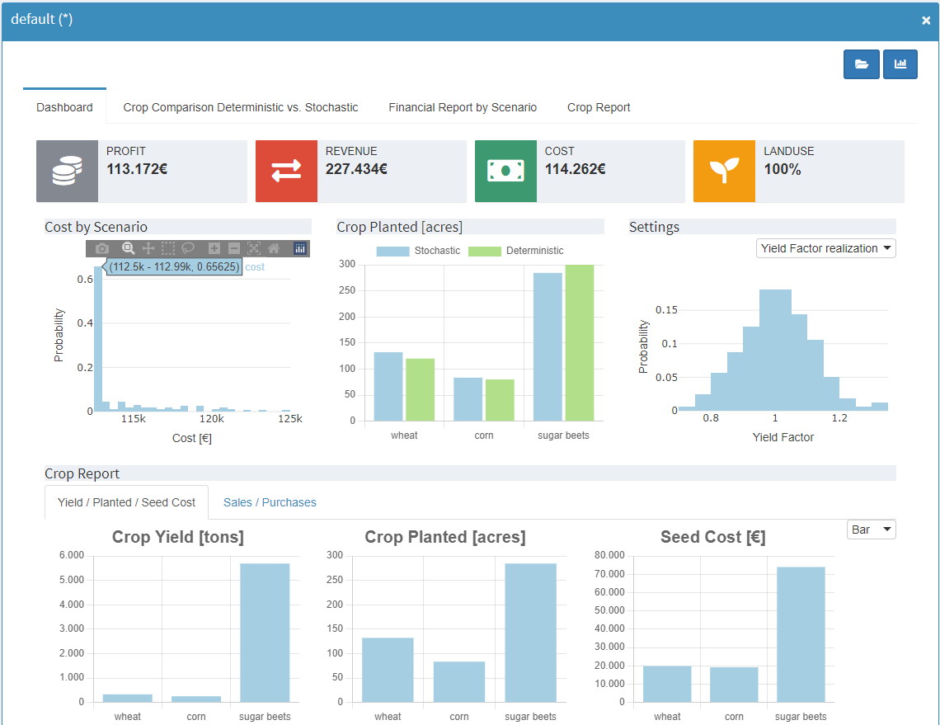
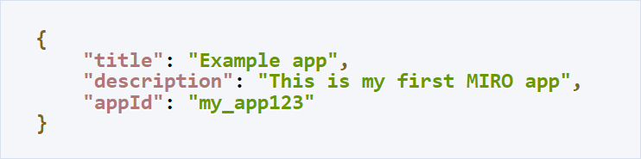
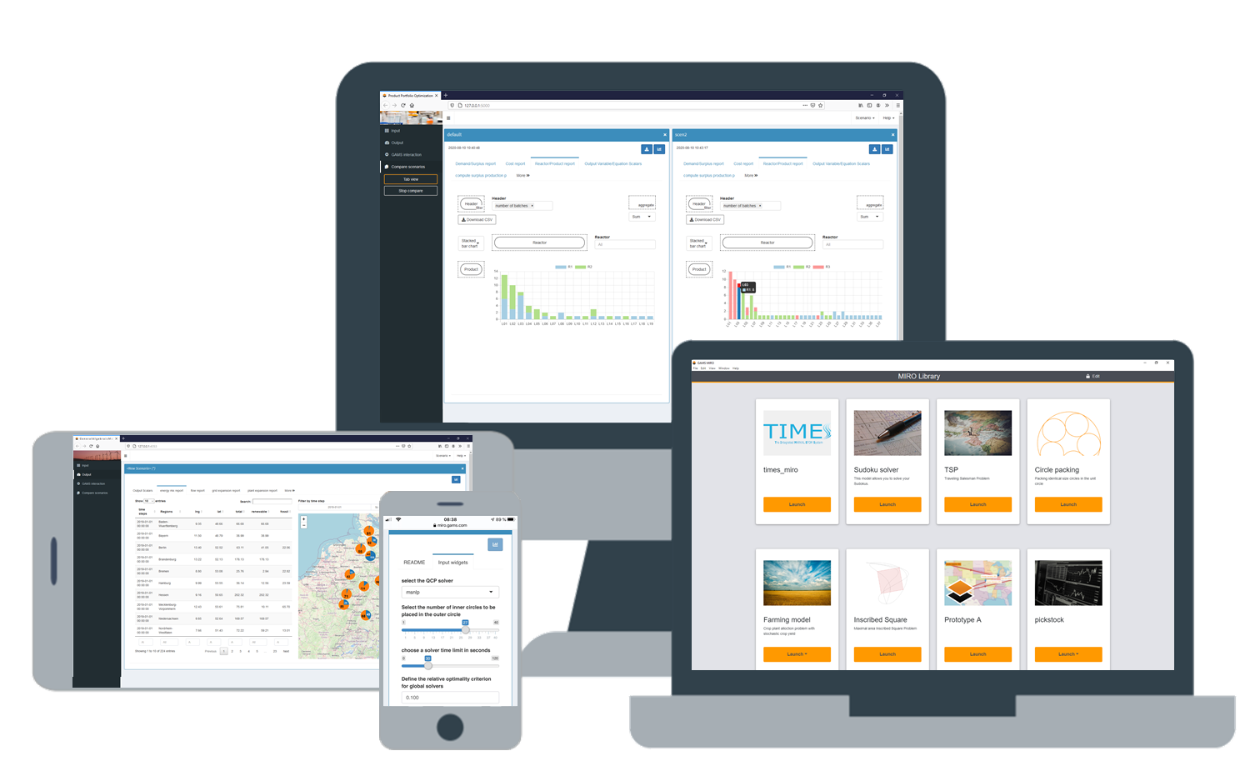
app development and deployment in gams miro
General
Model Annotation
App Configuration
Developing a MIRO application for a GAMS(Py) model involves some common steps. The easiest way for the development from scratch is to use GAMS Studio. It offers built-in functionality of the most important interactions with MIRO. For GAMSPy, any preferred code editor can be used.
$onExternalInput/$offExternalInput Symbols declared between tags are displayed as input data in MIRO (multiple use possible)
$onExternalOutput/$offExternalOutput Symbols declared between tags are displayed as output data in MIRO (multiple use possible)
Configuration & customization via MIRO Configuration Mode requires no programming knowledge
Appearance
Input widgets
Graphics
Table settings
Functionality
[…]
[…]
$onExternalInput
Parameters a(i) 'capacity’ / seattle 350
san-diego 600 /
Scalar f 'freight in dollars’ / 90 / ;
$offExternalInput
[…]
$onExternalOutput
Variables x(i,j) 'shipment quantities in cases'; $offExternalOutput
[…]
Solve transport using lp min z;
Iterative App Development
You don't usually go through all the steps once and end up with a finished MIRO application. Rather, it makes sense to develop the app iteratively. You can create your first working prototype very fast and give it away for testing. Enabling the end user to try out the application at an early stage of development can result in much better feedback!
Pie chart
Donut chart
Bar chart
Line chart
In GAMSPy, symbols that are annotated with is_miro_input=TRUE / is_miro_output=TRUE are displayed in MIRO .
Scatter plot
Bubble chart
Histogram
Time series diagram
a = Parameter(m, name="a", domain=i, records=capacities,
description="capacity“, is_miro_input=True)
x = Variable(m, name="x", domain=[i, j], type="Positive",
description="shipment quantities in cases",
is_miro_output=True)
Pivot Table
Dashboard
Gantt chart
> gamspy run miro --model <path_to_model> --path <path_to_MIRO_installation>
Map
Value box
Deployment
Advanced Configuration
Deploy a MIRO application and make it available to end users.
Custom renderers and widgets
Prerequisite
Model assembly file: Tell MIRO the files that belong to your model. Can be done using the “Assembly and Deploy” dialog in GAMS Studio.
Optional
App logo: Place an image inside the static_<modelname> folder which will be suggested to the user.
App info: Specify app title and description in a app_info.json file inside the static_<modelname> folder which will be suggested to the user. A custom app Id determines the URL under which the app can be reached on MIRO Server.
Mobile friendly app (progressive web app): For apps deployed on MIRO Server you can add a custom web app manifest. This allows you to customize name, logo, and more when your app is added to a user's home screen.
Sign MIRO app: Ensure that the app was created by a verified developer.
Bundle data: To distribute scenario data with the MIRO application, place valid MIROSCEN, GDX, CSV or XLSX files in the data_<modelname> directory.
Write custom R code to visualize (renderer) or generate (widget) data.
A custom input widget can communicate data of (multiple) input symbols with GAMS
With a custom renderer the data of (multiple) input/output symbols can be visualized
> gamspy run miro --mode=“deploy” --model <path_to_model> --path <path_to_MIRO_installation>
Custom scenario comparison / analysis
Custom scenario comparison modules can be used to perform tailored analyses for single or multiple scenarios.
Hypercube jobs
Other features
Execution of multiple automatically generated scenarios that differ in their parameterization.
Requires GAMS MIRO Server.
There are a few options that are not available in the Configuration Mode. These have to be configured manually. Examples:
Custom data connectors: Communicate data with external sources (e.g. databases)
Dashboard renderer: Interactive tool that can display multiple charts and tables.
Dropdown menus in input table
GAMS Software GmbH
www.gams.com
sales@gams.com
GAMS MIRO version 2.11.0
Updated: 2024-08-05

Slide 2



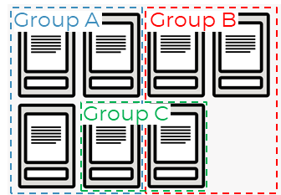


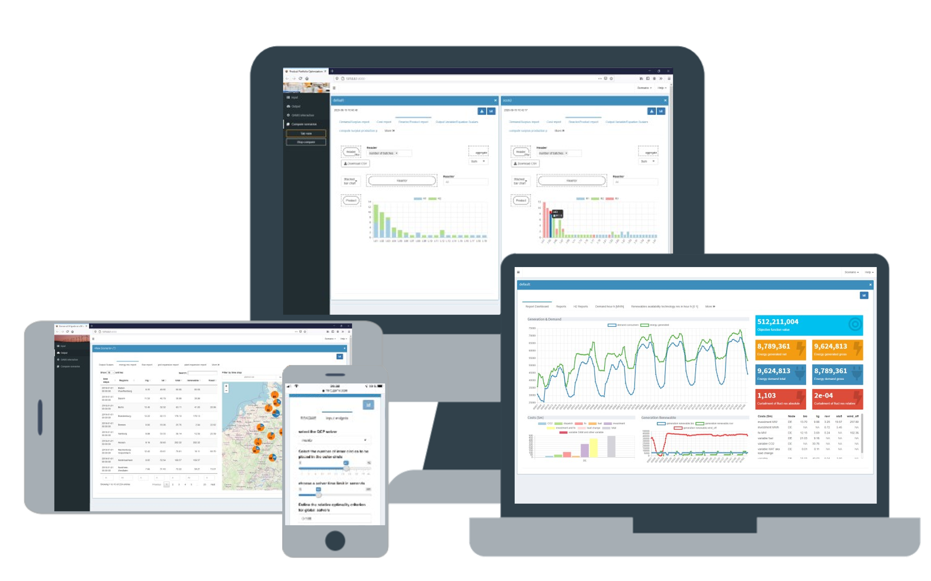
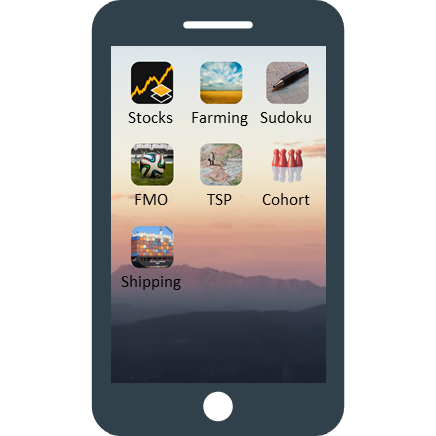
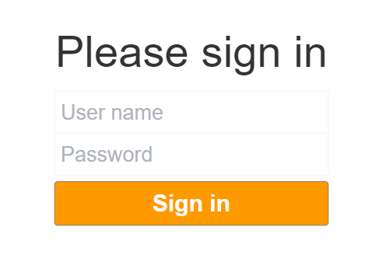
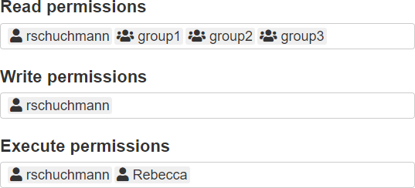

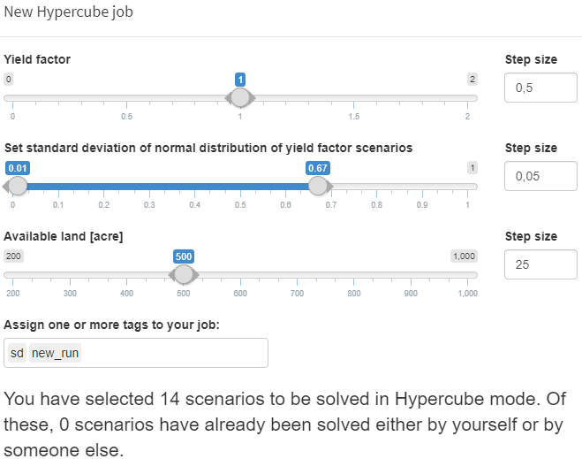

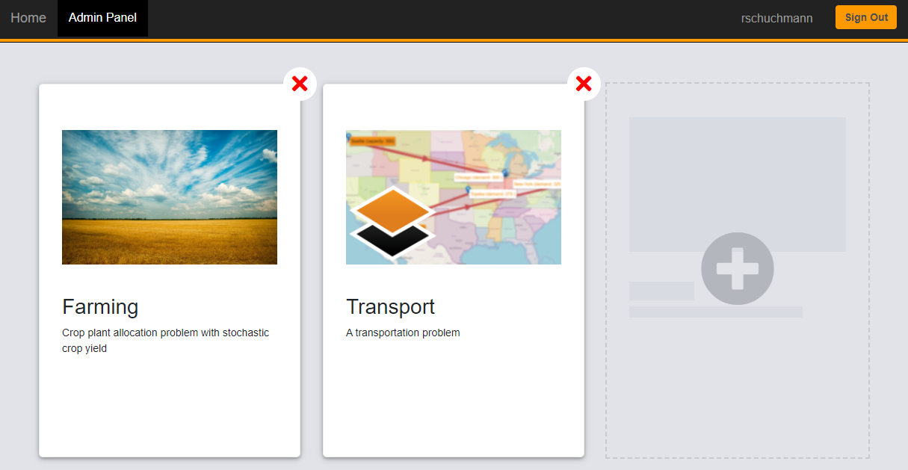
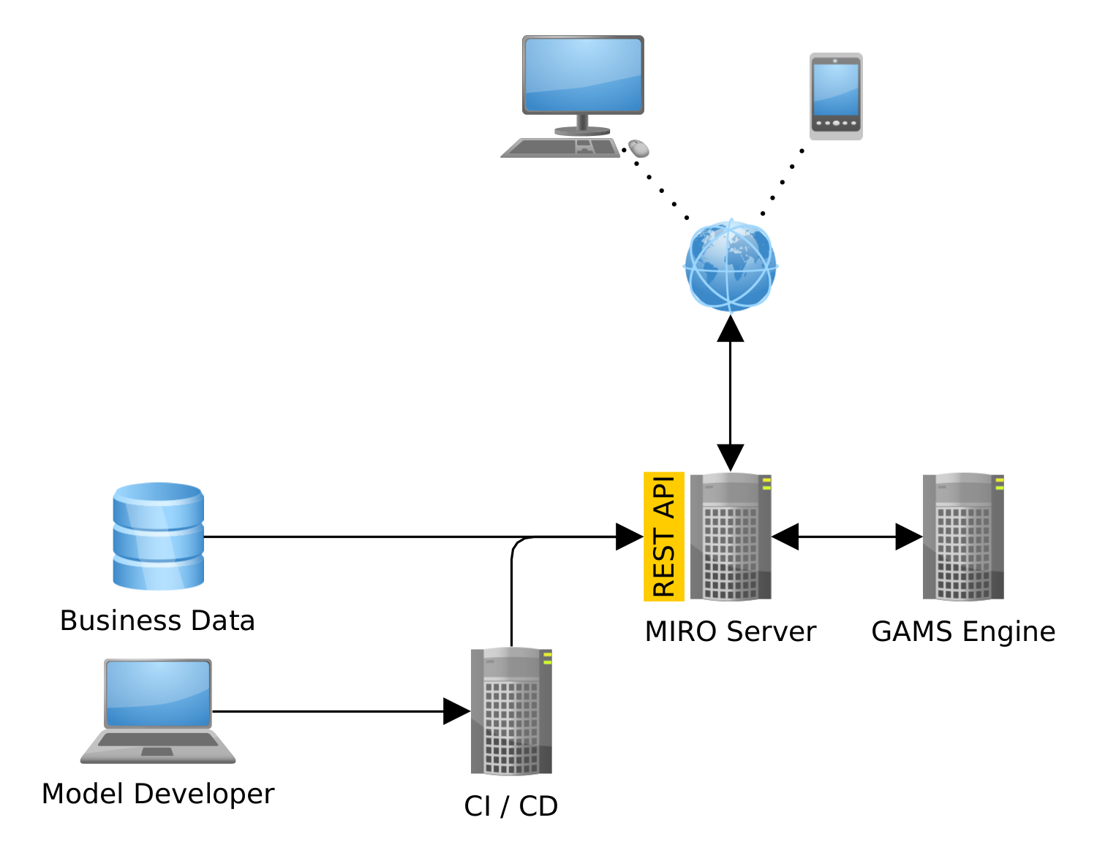
gams miro server
General
User- and Group Management
With GAMS MIRO Server, the model calculations and the MIRO applications are moved to the cloud. Apps deployed with MIRO Server can be accessed from any device with a modern web browser. Local software or licenses are not necessary. All you need as a user is a URL and credentials (optional). This makes MIRO Server the most convenient solution for making applications available to users around the world.
MIRO Server uses the highly flexible user management and authentication system of GAMS Engine. It allows you to restrict the activities of your users according to your organizational hierarchy.
Divide MIRO users into (multiple) groups with different privileges and decide who can see which apps and/or who has control over adding new ones. All users access MIRO Server via the same URL. However, as a member of a group, you don't see anything from other apps from other groups.
Limit the solve time as well as the disk usage of individual users or groups of users.
MIRO Server can also be used without authentication. In this way, MIRO apps can be showcased and made available to everyone.
Prerequisites
MIRO Server is seamlessly linked with GAMS Engine, a server software that allows you to run GAMS models on centralized compute resources. It handles the entire job management, scheduling and load balancing of your computationally intensive optimization problems.
Scenario Sharing
If several users have access to the same MIRO Server app, they can share scenarios. Shared scenarios can be loaded from the database in the same way as own scenarios. As scenario owner you decide about who has read, write and execute permissions.
Administrator Panel and REST API
More Features / Advantages
Admin panel
Asynchronous solving: Submit jobs and log back in later to get the results.
Hypercube jobs: Execution of multiple automatically generated scenarios that differ in their parameterization.
A MIRO app can be used as a progressive web app on mobile devices, which makes it behave almost like other regular apps.
Server Hardware has faster CPUs and more RAM than typical PCs and Laptops.
Centralized license administration, no limits on number of users.
Ensure that everyone uses the same app/model version.
Rolling updates keep everything current and secure.
Apps and scenario data can be shared among users and user groups. MIRO Server administrators can manage apps and scenario data via a graphical admin interface.
Add/update/remove MIRO apps
Control app access (user/group based)
Add scenario data to apps
REST API
Apps and scenario data in MIRO Server can also be managed via a REST API. All operations that create, read, update or delete MIRO apps as well as MIRO scenarios are supported. This way MIRO Server can be easily integrated into your existing infrastructure and interact with upstream and downstream systems.
GAMS Software GmbH
www.gams.com
sales@gams.com
GAMS MIRO version 2.11.0
Updated: 2024-08-05

Slide 3
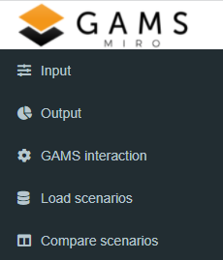
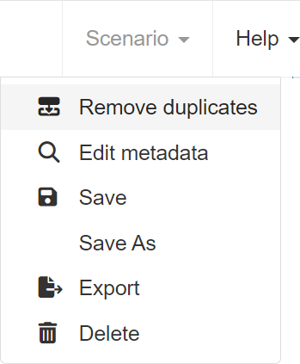





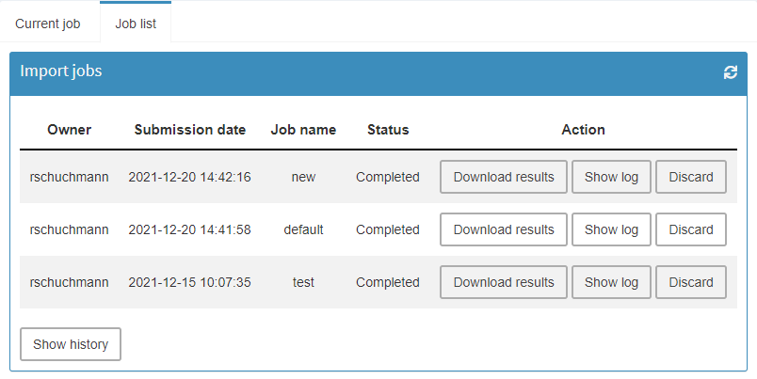
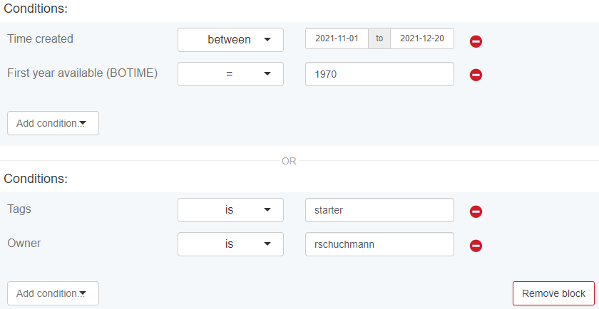
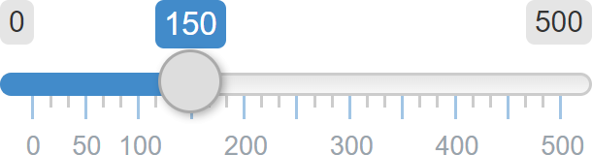
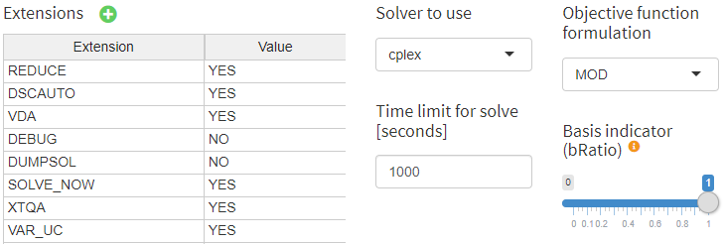
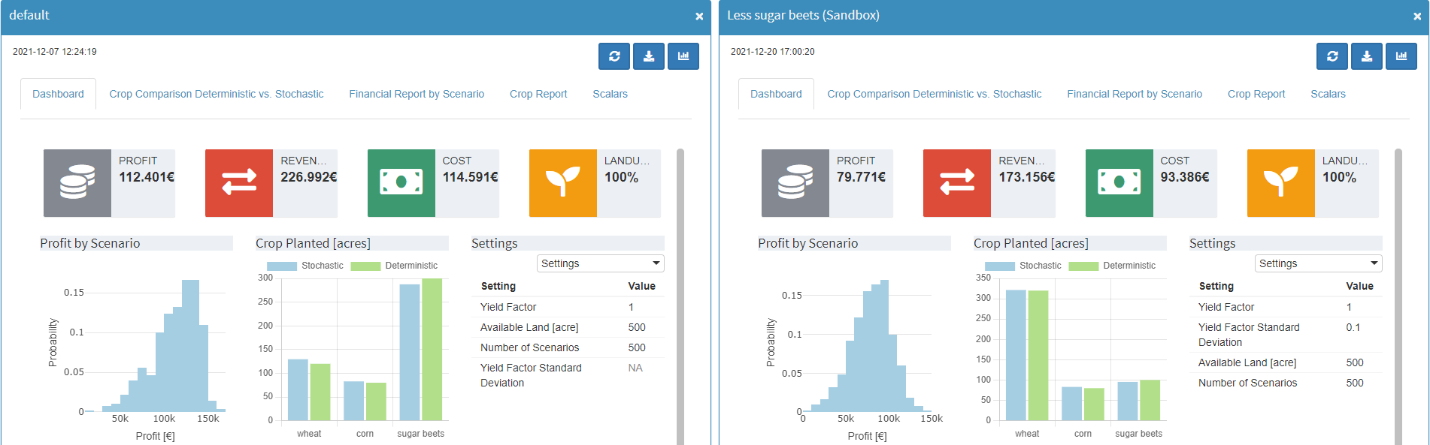
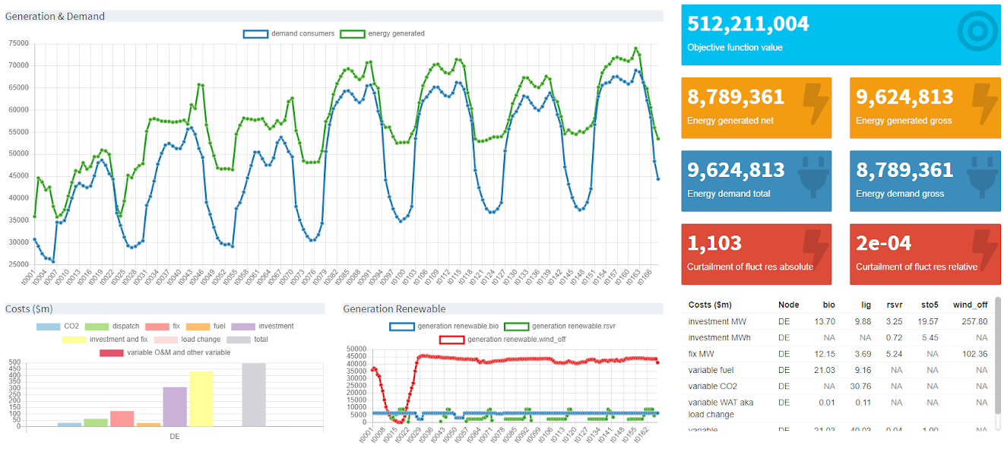
gams miro - interface
General
Navigation Bar
Header Bar
GAMS MIRO enables you to turn your GAMS(Py) models into fully-fledged applications that are easy to distribute. An intuitive user interface allows you to interact with the underlying GAMS model, quickly create scenarios, compare results and much more. Choose from a variety of powerful charts, maps, pivot tables, and other tools to gain deeper insights into the characteristics of your data and the optimization problem. GAMS MIRO can be used as a local application, a hybrid of a local application that performs model calculations in a highly scalable cloud setup, up to a pure server setup that can be accessed from anywhere.
The navigation bar is used to switch between the different submenus of a MIRO application.
Scenario
Save and delete a scenario.
Export a scenario (GDX, CSV, XLS, MIROSCEN)
Edit scenario metadata
Scenario name and tag(s)
File attachments Can be used as additional model input data or scenario information. Can also automatically be attached after a GAMS(Py) run (e.g. reports)
Views: Store configurations of renderers, e.g. of a pivot table.
Access permissions: Share a scenario with other users (requires GAMS MIRO Server).
Remove duplicates: Remove duplicate records from input data.
Help
Link to the documentation, the GAMS forum and license information; access to the command palette.
Input
Modification & visualization of input data for a model run.
Output
Visualization of output data.
GAMS interaction
Shows status, logs and listing files of a model run.
Load scenarios
Slice & dice the database to fetch scenarios you are interested in.
Compare scenarios
Module for the comparison of scenarios
Model Input and Output
GAMS Interaction
Load Scenarios
Model input data is located in the input section, the results are displayed in the output panel. Together with the scenario metadata, this is called a sandbox scenario. Per default, each symbol that is marked in the GAMS(Py) model for use with MIRO is displayed in a separate tab. Exceptions are scalar symbols (incl. singleton sets), which are collected in a joint table.
During the calculations, MIRO shows the GAMS interaction section where the GAMS log and listing file are located. User-defined logs can also be displayed here. Asynchronously submitted jobs (requires GAMS MIRO Server) are displayed in the Job list tab, from where the results can also be imported.
MIRO has a powerful batch load module which helps finding and loading exactly the saved scenarios of interest. It allows the graphically assisted creation of complex database queries. Filters can be applied to scenario metadata such as time of creation, name, owner, or scenario tags. It is also possible to filter by input and output scalars used in the model.
Widgets for input symbols
Widgets are used to communicate data with GAMS(Py). Tables are the default input widgets. Data for scalar input symbols can be communicated via sliders, dropdown menus, checkboxes or numeric inputs.
By utilizing custom input widgets (self-written R code) instead of standard tables, data can be communicated to the model in a fully customized manner, also for multiple symbols.
Data
Scenario Comparison and Analysis
The input data to be communicated with GAMS(Py) can be loaded from existing scenarios in the database, imported via local files, or entered manually. Data can also come from external sources (e.g. databases) by using custom data connectors. By clicking on solve, MIRO collects the data from the input widgets and sends it to GAMS(Py) via a GDX file. After the model run, the output data is passed back to MIRO in the same format. If enabled, all temporarily created files of the model run can be accessed.
To compare input and/or output data from different model runs, MIRO has four built-in scenario comparison modes.
Split / tab view comparison
Scenarios are compared with each other as they are visible in the sandbox. All configured graphs and tables are available for direct comparison.
Pivot comparison
The data all selected scenarios is merged into a powerful pivot table with an additional scenario dimension. Data can be filtered, aggregated, pivoted and visualized with a variety of charts. Also, views can be used here.
Renderers
Dashboard comparison
For each input and output symbol a tabular as well as a graphical data representation can be configured. As with custom input widgets, self-written R code can be used to customize the visualization and combine data from multiple symbols into one graph.
Compare the data of several selected scenarios in an interactive dashboard. Requires an application-specific configuration.
Custom scenario comparison / analysis
GAMS Software GmbH
www.gams.com
sales@gams.com
GAMS MIRO version 2.11.0
Updated: 2024-08-05
Custom scenario comparison modules can be used to perform tailored analyses for single or multiple scenarios.

Slide 4
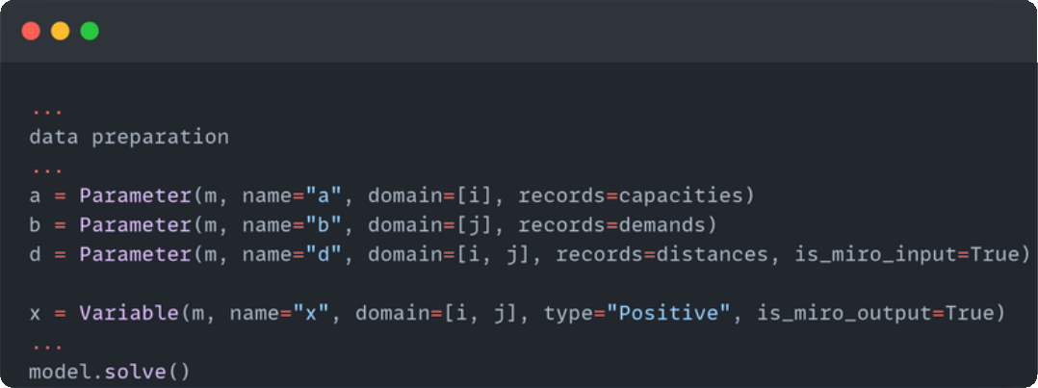
Pie chart
Donut chart
Bar chart
Line chart
Scatter plot
Bubble chart
Histogram
Time series diagram
Pivot Table
Dashboard
Gantt chart
Map
Value box

Slide 5

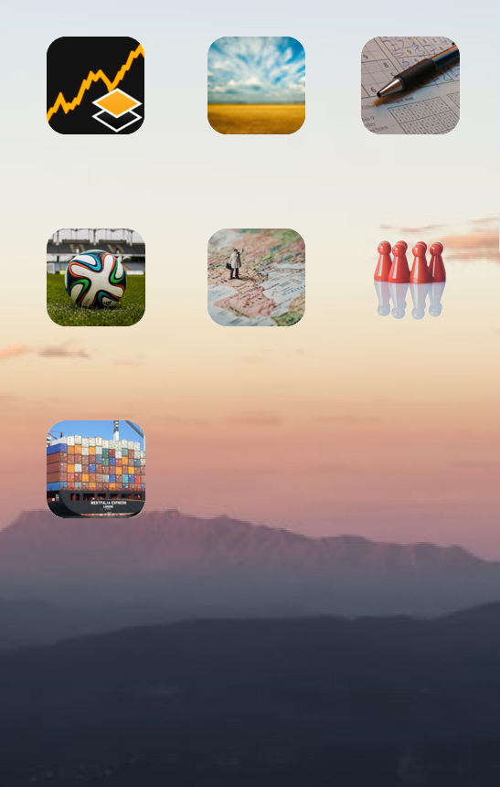










Stocks
Farming
Sudoku
Stocks
Farming
Sudoku
FMO
TSP
Cohort
FMO
TSP
Cohort
Shipping
Stocks
Stocks
Farming
Sudoku
Stocks
Farming
Sudoku
Stocks
Farming
Sudoku
Stocks
Farming
Sudoku
Stocks
Farming
Sudoku
FMO
TSP
Cohort
FMO
TSP
Cohort
FMO
TSP
Cohort
FMO
TSP
Cohort
FMO
TSP
Cohort
Shipping
Stocks
Shipping
Stocks
Stocks
Stocks
Farming
Sudoku
FMO
TSP
Cohort
Stocks

